Slide 1

Architectural Patterns
for a competitive advantage
Grady Booch
Chief Scientist
Rational Software Corporation

Slide 2
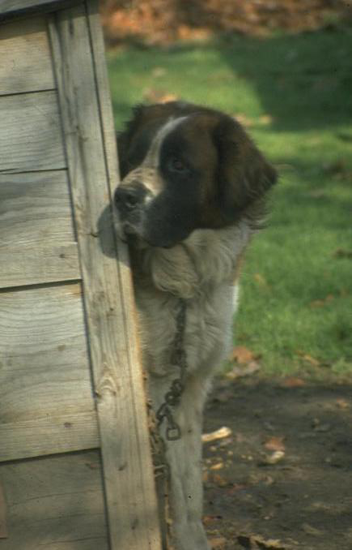
Architecting a doghouse

Slide 3
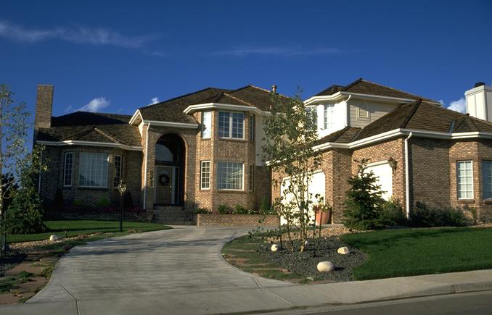
Architecting a house

Slide 4
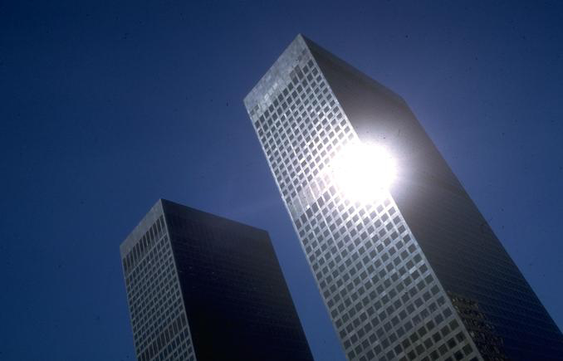
Architecting a high rise

Slide 5
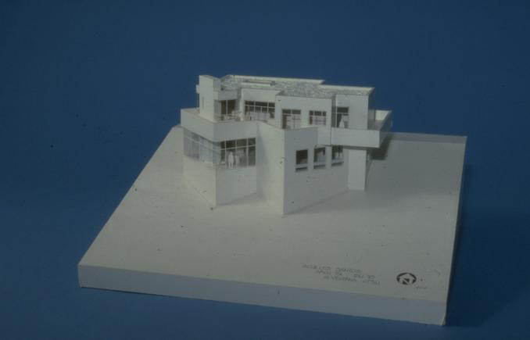
Modeling a house

Slide 6
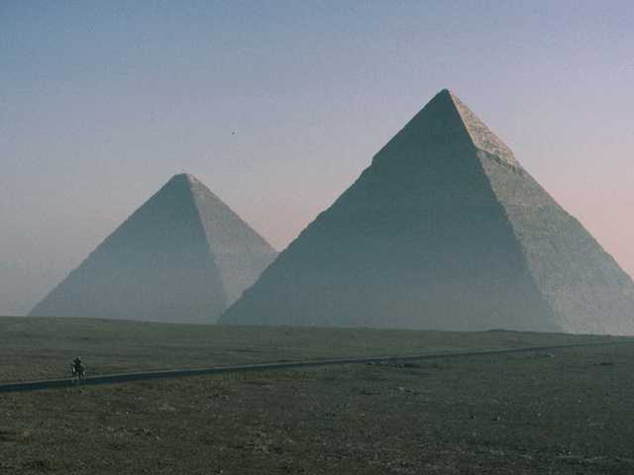
Classical architecture
Progress
- Limited knowledge of theory

Slide 7
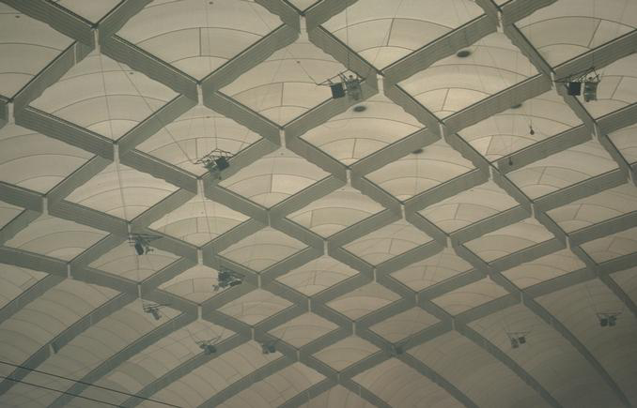
Modern architecture
Progress
- Advances in materials
- Advances in analysis
Progress
- 5 times the span of the Pantheon
- 3 times the height of Cheops

Slide 8
Movements in civil architecture
Bronze age/Egyptian (Imhotep)
Grecian/Roman (Vitruvius)
Byzantine/Romanesque
Gothic
Mannerism (Michelangelo, Palladio)
Baroque
Engineering/Rational/National/Romantic
Art noveau
Modern movement (Wright, LeCorbusier)
Progress
- Imitation of previous efforts
- Learning from failure
- Integration of other forces
- Experimentation

Slide 9
Kinds of civil architectures
Neufert Architect’s Data
The Handbook of Building Types
Community
  houses, flats and apartments, gardens, education, hospitals, religion
Commerce
  shops and stores, restaurants, hotels, office buildings, banks, airports
Industry
  industrial buildings, laboratories, farm buildings
Leisure
  sport, theaters and cinemas, museums

Slide 10
Forces in civil architecture
Load
Kinds of loads
- Dead loads
- Live loads
- Dynamic loads
Compression
Tension
Avoiding failure
- Safety factors
- Redundancy
- Equilibrium
Load
Any time you depart from established practice, make ten times the
effort, ten times the investigation. Especially on a very large project.
- LeMessuier

Slide 11
Shearing layers of change
Stewart Brand, How Buildings Learn
Space plan
Services
Stuff
Structure
Skin
Site

Slide 12
Dimensions of complexity
Walker Royce, Rational
Higher technical complexity
- Embedded, real-time, distributed, fault-tolerant
- Custom, unprecedented, architecture reengineering
- High performance
An average software project:
- 5-10 people
- 10-15 month duration
- 3-5 external interfaces
- Some unknowns & risks
Telecom
Switch
Defense
Weapon System
Commercial
Compiler
National Air Traffic
Control System
Embedded
Automotive
Software
Lower
management
complexity
- Small scale
- Informal
- Single stakeholder
- “Products”
CASE Tool
Large-Scale
Organization/Entity
Simulation
Higher
management
complexity
- Large scale
- Contractual
- Many stake holders
- “Projects”
Small Scientific
Simulation
IS Application
Distributed Objects
(Order Entry)
Enterprise IS
(Family of IS
Applications)
Defense
MIS System
IS Application
GUI/RDB
(Order Entry)
Business
Spreadsheet
Lower technical complexity
- Mostly 4GL, or component-based
- Application reengineering
- Interactive performance

Slide 13

Forces in software architecture
Functionality
Technology churn
Performance
Resilience
Differences
- No moving parts
- New materials can be created
- Physics can be changed
Throughput
Fail safe
Avoiding failure
- Separation of concerns
- Semantic consistency
- Distribution of responsibilities
Capacity
Fault tolerance
Availability
Have an architecture that makes sense before you write 3.5 million
lines of code.
- Patrick Naugton

Slide 14
Architecture-centric
Richard Gabriel
Purpose
  intellectual control
  basis for reuse
  basis for project management; risk reduction
Representation
  4+1 view model
Process
  iterative and incremental development
  successive refinement of an executable architecture
Approaches
- Worse-is-better
- The Right Thing

Slide 15
Architecture defined
Mary Shaw, CMU
Grady Booch,
Philippe Kruchten,
Rich Reitman
Kurt Bittner, Rational
Software architecture encompasses the set of significant decisions about the organization of a software system
  selection of the structural elements and their interfaces by which a system is composed
  behavior as specified in collaborations among those elements
  composition of these structural and behavioral elements into larger subsystem
  architectural style that guides this organization

Slide 16
Architecture defined
Mary Shaw, CMU
Grady Booch,
Philippe Kruchten,
Rich Reitman
Kurt Bittner, Rational
Software architecture also involves
  usage
  functionality
  performance
  resilience
  reuse
  comprehensibility
  economic and technology constraints and tradeoffs
  aesthetic concerns

Slide 17
The 4+1 view model
Philippe Kruchten, Rational
End user
- Functionality
- Vocabulary
Programmers
- Software management
Design
view
Component
view
U
Analysts/Testers
- Behavior
Use case
view
Process
view
Deployment
view
System integrators
- Performance
- Scalability
- Throughput
System engineering
- System topology
- Delivery and installation
- Communication

Slide 18

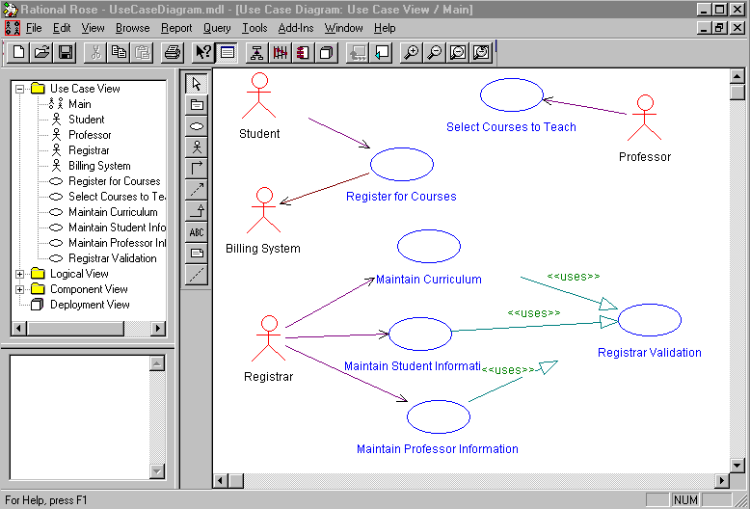
Use case diagram

Slide 19
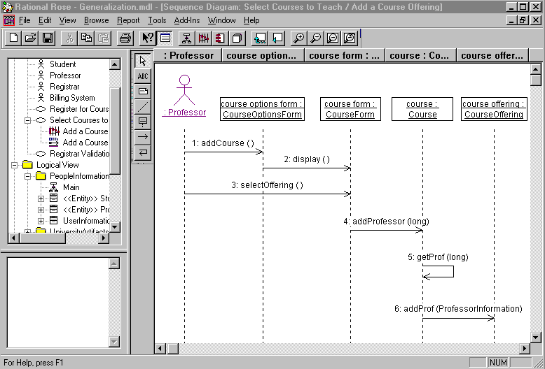
Scenario diagram

Slide 20
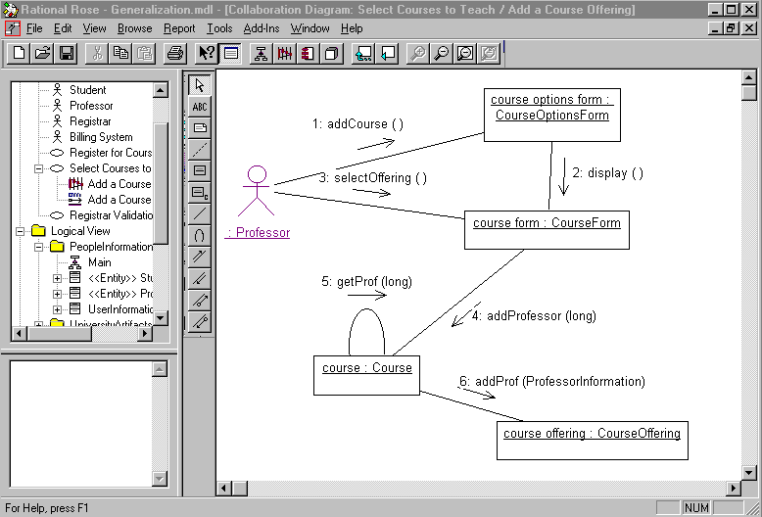
Collaboration diagram

Slide 21
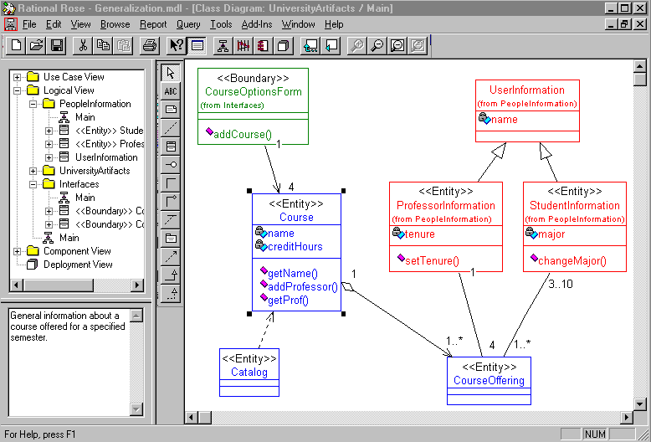
Class diagram

Slide 22
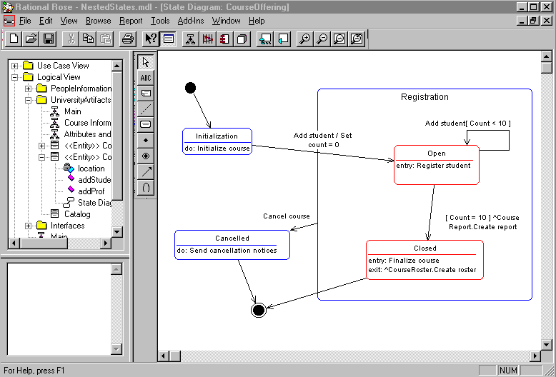
State transition diagram

Slide 23
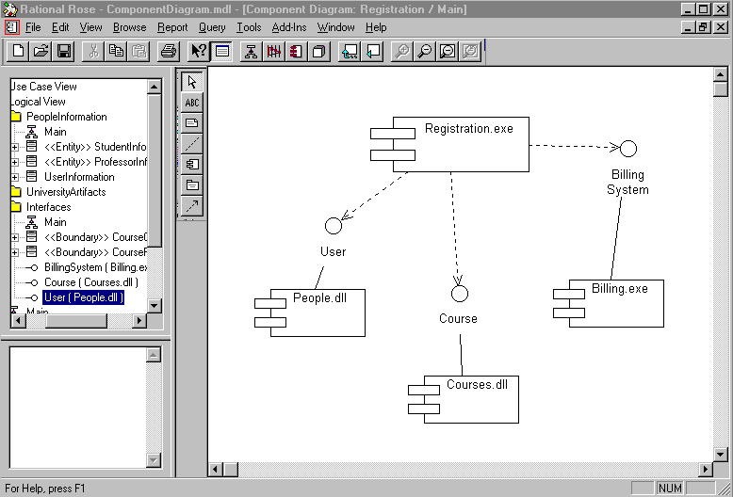
Component diagram

Slide 24
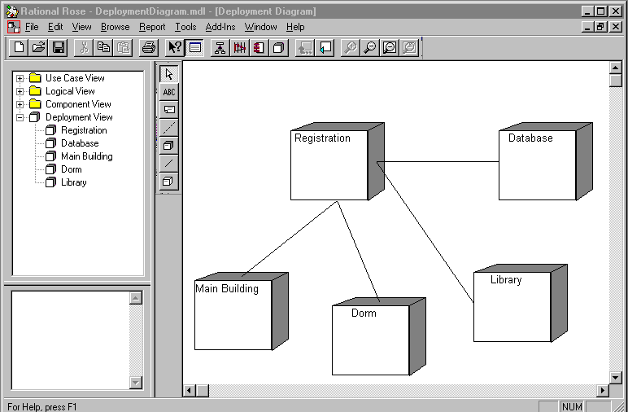
Deployment diagram

Slide 25
Relationships among views
Design view
Component view
α
Process view
β
Deployment view

Slide 26
Patterns
A pattern is a solution to a problem in a context
A pattern codifies specific knowledge collected from experience in a domain
All well-structured systems are full of patterns
  idioms
  design patterns
  architectural patterns

Slide 27
Design patterns
Gamma et al
Design Patterns
Creational patterns
  abstract factory
  prototype
Structural patterns
  adapter
  bridge
  proxy
Behavioral patterns
  chain of responsibility
  mediator
  visitor
Mechanisms are the soul of an architecture

Slide 28
Architectural patterns
Shaw and Garlan
Software Architecture
Buschmann et al
A System of Patterns
Booch
Distributed
Event-driven
Frame-based
Batch
Pipes and filters
Repository-centric
Blackboard
Interpreter
Rule-based
Layered
MVC
IR-centric
Subsumption
Disposable
Patentable
- Hughes CAATS

Slide 29
Taxonomy
Shaw and Garlan
Software Architecture in Practice
Data flow
  dominated by motion of data through the system
Kinds
  batch sequential
  data flow network
  pipes and filters

Slide 30
Taxonomy
Shaw and Garlan
Software Architecture in Practice
Call and return
  dominated by order of computation
Examples
  main program/subroutines
  abstract data types
  object
  call based client/server
  layered

Slide 31
Taxonomy
Shaw and Garlan
Software Architecture in Practice
Independent components
  Dominated by communication patterns
Examples
  event systems
  communicating processes

Slide 32
Taxonomy
Shaw and Garlan
Software Architecture in Practice
Data-centered
  dominated by a complex central data store, manipulated by independent computations
Examples
  repository
  blackboard

Slide 33
Taxonomy
Shaw and Garlan
Software Architecture in Practice
Virtual machine
  characterized by translation of one instruction set into another
Examples
  interpreter

Slide 34
Layered architecture
Issues
- Separation of concerns
Applications& interfaces
Major processes
Domain classes
Mechanisms
Services

Slide 35

Distributed architecture
Issues
- DCOM vs EJB vs CORBA
- Distribution and migration
- Fine grain/large grain objects
- Stateless vs stateful services
- Clustering
- Replication
Clients
Mechanisms
- RPC
- Transaction
- Atomicity
- Consistency
- Isolation
- Durability
- Messaging
- Conversation
- Request/response
- Publish and subscribe
- Broadcast
LAN
WAN
Servers

Slide 36
Commercial frameworks
MTS/MSQS
CORBA
Enterprise Java Beans
Domino
SAP R/3
Delphi
Forte
Visual Basic
Similar to building
codes or local
covenants

Slide 37
DCOM architecture
Machine x
Machine y
Proxy
Standalone
server
Container
In-process
server
Container
In-process
server

Slide 38
MTS architecture
David Chappell
MTS executive
Server
Class factory
wrapper
Class
factory
Client
Proxy
Stub
Context
wrapper
MTS
object
Context
object

Slide 39
CORBA architecture
Mowbray et al, Inside CORBA
Application objects
- Organization specific
CORBA facilities
- User interface
- Information management
- System management
- Task management
CORBA domains
- Financial services
- Health care
- Telecommunications
- Other
Object request broker
CORBA services
- Concurrency - Lifecycle - Trade - Query
- Events - Naming - Start up - Relationships
- Externalization - Security - Persistence - Transactions
- Licensing - Time - Properties - Collections

Slide 40
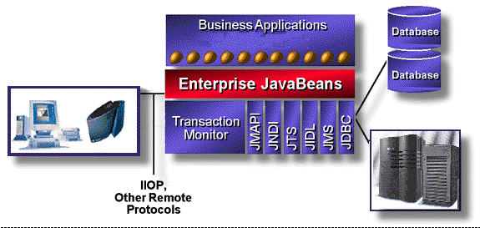
EJB architecture
Bill Roth, JavaSoft
©1998, Sun Microsystems, Inc.

Slide 41
Architectural context
The choice of which building code or covenant you chose to live under is an architectural decision
  but by no means is this a sufficient architectural decision

Slide 42
Case studies
CAATS
Ship System 2000
AWACS modernization
trading system
credit card processing
cellular phone network
cable television operations

Slide 43
Sources of architecture
Method
Method
Theft
Intuition
Theft
Intuition
Classical system
Unprecedented system

Slide 44
Focus over time
Discovery
Invention
Implementation
Focus
Time

Slide 45
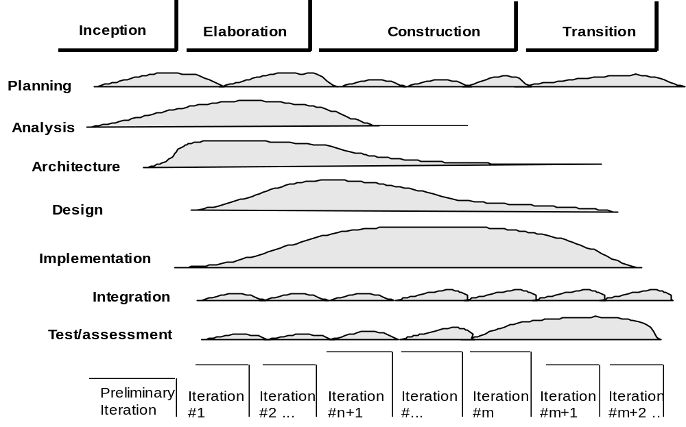
Architecture across the lifecycle

Slide 46
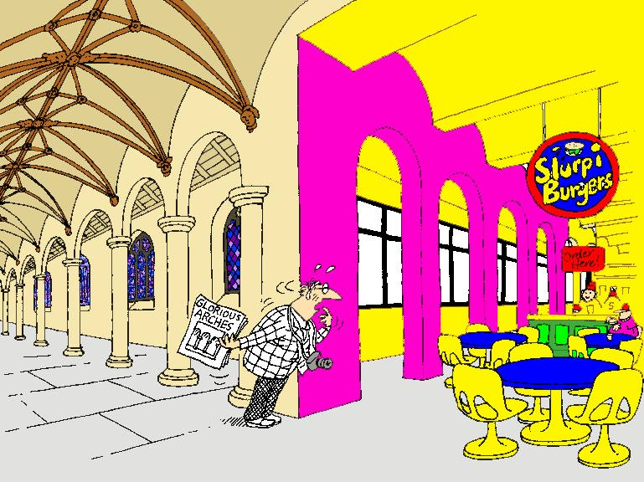
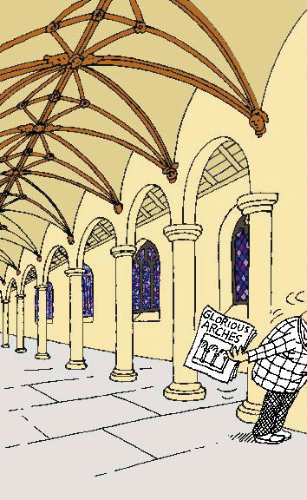
Conceptual integrity

Slide 47
Futures
Support for CBD
ADL: Architecture Description Languages
  UML, UniCon, LILEAnna, P++, LEAP, Wright, µRapid
Standardization of concepts
  IEEE Working Group on Architecture
  INCOSE Working Group on System Architecture
Systematic capture of architectural patterns

Slide 48
For more information
Email: egb@rational.com
URL: http://www.rational.com

